Slide 1
Stat 495r – Presenting Data
Week 5
Preattentive Pop-outs, Takeaways and ggplot

Slide 2
Announcements
Homework
It’s a workplace simulation
Don’t include mentions of it being “homework”
Do immerse yourself in the scenario and give takeaway statements
Do include section dividers
Do send in PDF
Now that a few classes have gone by, there amount of latitude diminishes – in other words, I’m going to be a bit stricter and nitpicky in the grading
The homework load is light today (since I get the feeling students are getting stressed with life)
You’re the masters of your own schedules, but do let me know if you are not going to be in class – don’t ghost
3 more weeks of in-person class option – fully remote after
What are your feelings about doing a visualization project for a real company instead of homework?

Slide 3
Agenda
Pre-attentive Pop-outs
Gestalt Principals
Takeaway Statements
Ggplot2
Activity - Video

Slide 4
Data Vizzes of the Week

Slide 5
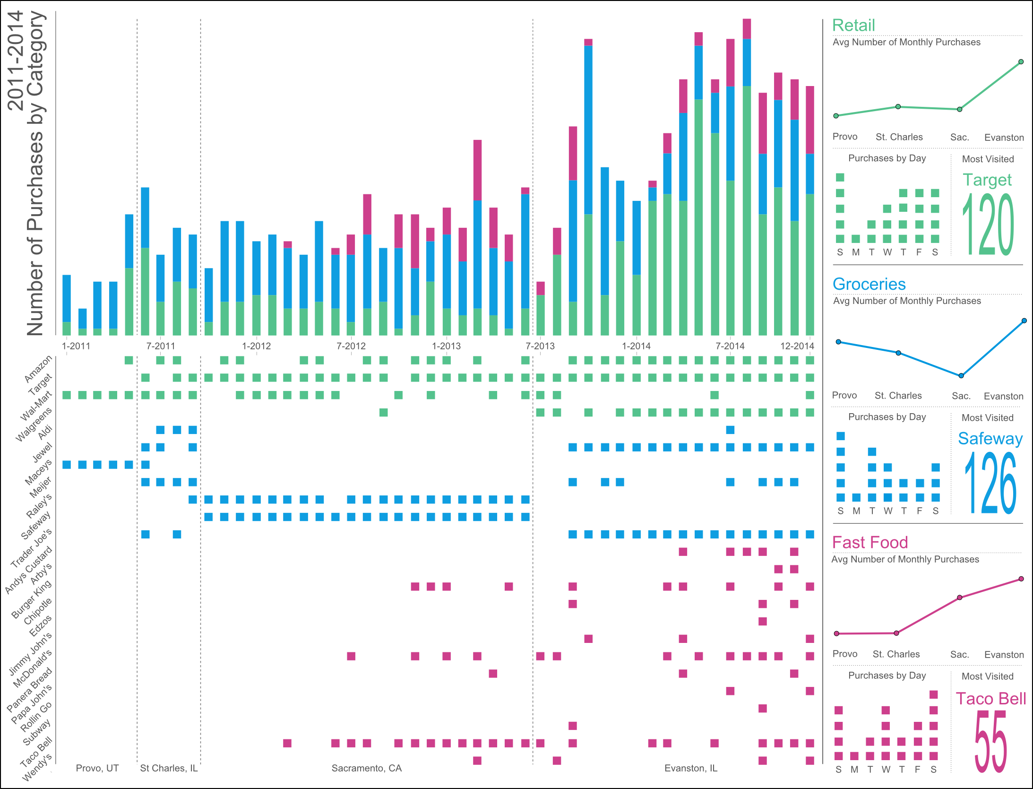
Data Viz #1
Source: Matt Yancey https://medium.com/@mattyancey/purchase-history-of-2011-2014-72bf8cf1f85a

Slide 6
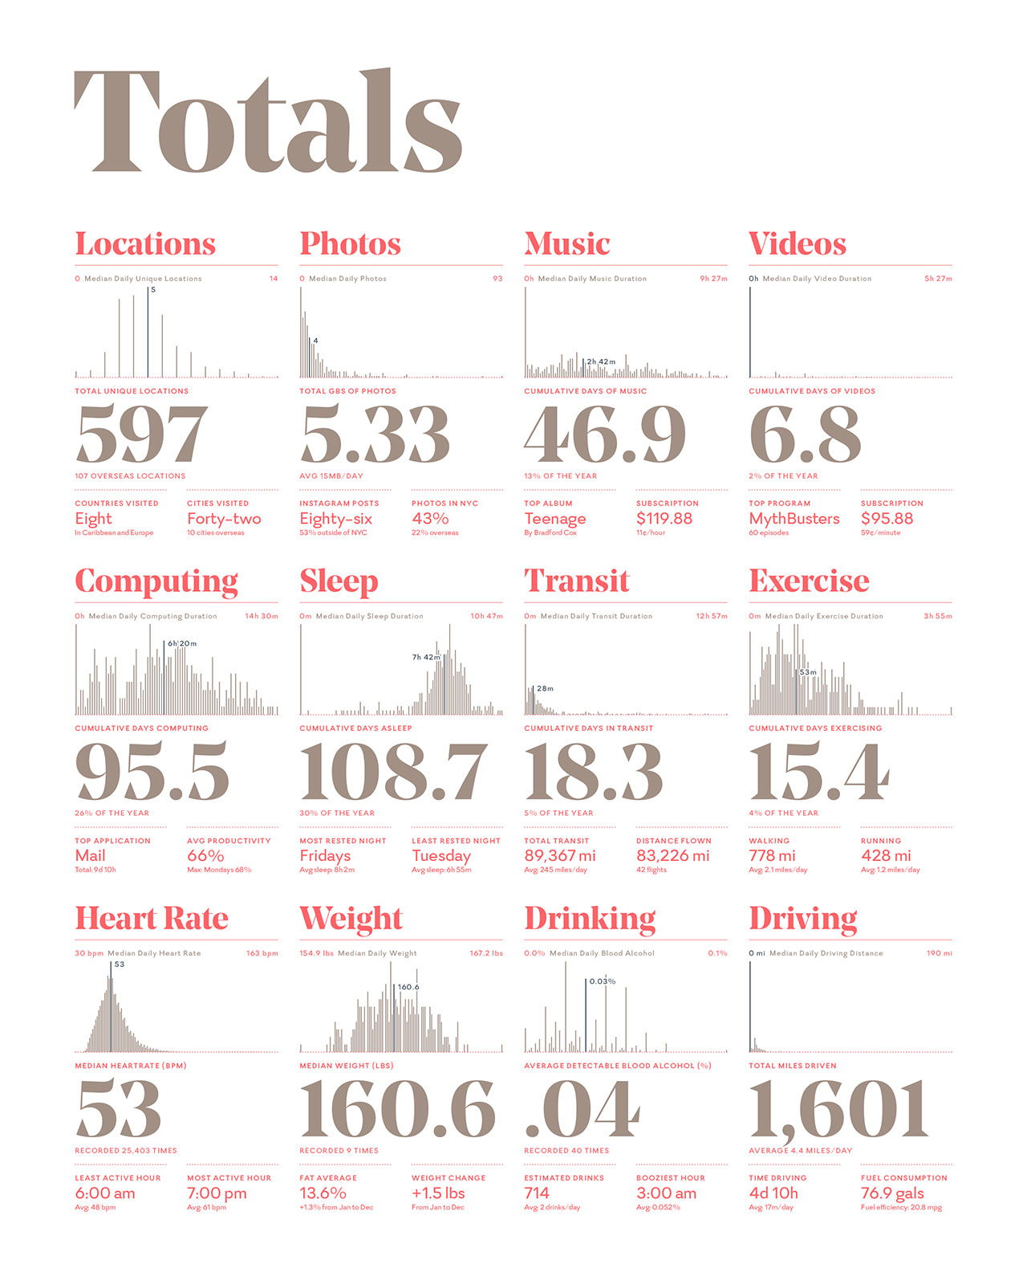
Data Viz #2
Source: Nick Feltron http://feltron.com/FAR14.html

Slide 7
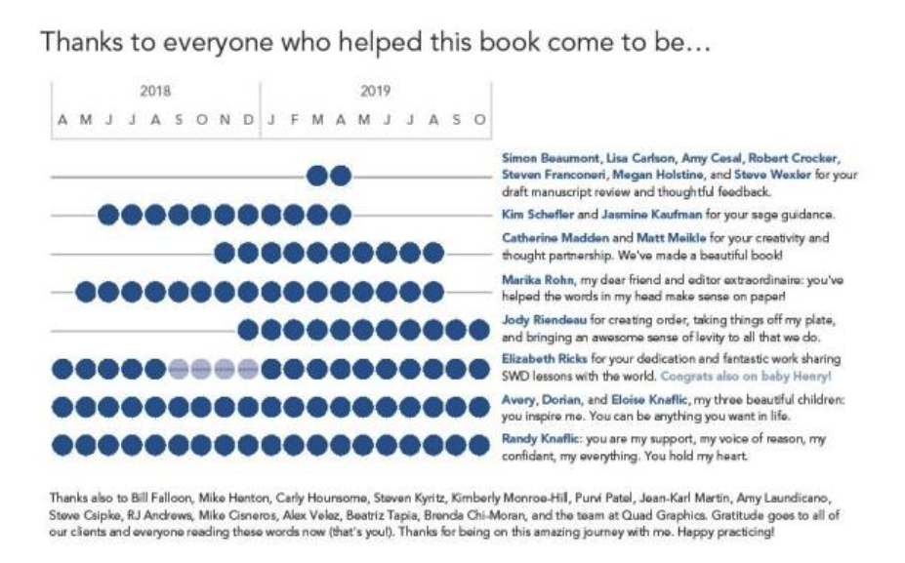
Data Viz #3
Let’s Practice, Cole Nussbaumer Knaflic

Slide 8
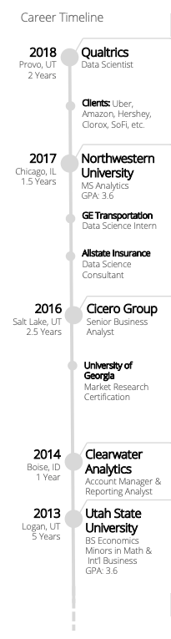

Slide 9
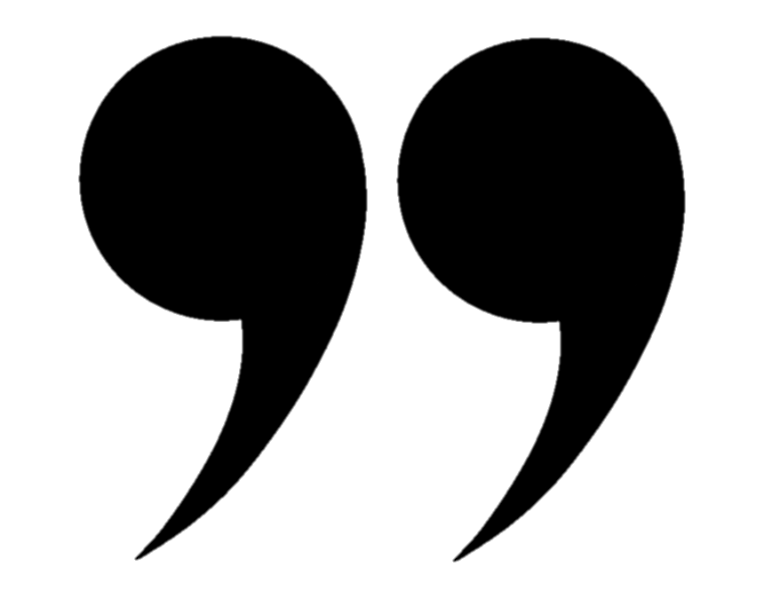
Quote of the Week
To make the jump from data to visualization, you must know the ingredients. A skilled chef doesn’t blindly throw ingredients in a pot, turn the stove on high, and hope for the best. Instead the chef gets to know how each ingredient works together, which ones don’t get along, and how long and at what temperature to cook these ingredients.

Slide 10
Video Review
What channels were used?
How does displaying the data tell a previously unknown story?
What is the story the data showed? What is the one-line summary?
Which was your favorite visual?
How did he use non-data channels to tell a story?
How does Hans Roslings’ passion help?

Slide 11
Gestalt Principals

Slide 12
Gestalt Principals of Visual Perception
Closure
Connection
Proximity
Similarity
Enclosure
Continuation

Slide 13
Using Proximity
 | Overall Win Rate | My Teams Win Rate
2018 - Q4 | 44% | 60%
2019 - Q1 | 42% | 56%
2019 - Q2 | 44% | 48%
2019 - Q3 | 41% | 58%
 | TOT | TEAM
2018 - Q4 | 44% | 60%
2019 - Q1 | 42% | 56%
2019 - Q2 | 44% | 48%
2019 - Q3 | 41% | 58%
Which direction do you read on these tables?

Slide 14
Using similarity
What’s the difference between the bars?

Slide 15
Using Closure
What’s special about April?

Slide 16
Using Connection
How are the dots related?

Slide 17
Using enclosure
Where is the axis? Why is it not needed?

Slide 18
Using Continuation
Do the bars extend to the end?
Education
Manufacturing and Forestry
Advertising and Creative

Slide 19
Pre-attentive Attributes

Slide 20
Pre-attentive Attributes in Text
Caps
Bold
Color
Size
Italics
White space
Enclosure
Underline
The quick brown FOX jumps over the lazy DOG
The quick brown fox jumps over the lazy dog
The quick brown fox jumps over the lazy dog
The quick brown fox jumps over the lazy dog
The quick brown fox jumps over the lazy dog
The quick brown fox jumps over the lazy dog
The quick brown fox jumps over the lazy dog
The quick brown fox jumps over the lazy dog
Use together
Don’t use. Try to have only 2 font sizes ever. Maybe 3.
Barely noticeable
Use sparingly

Slide 21
Pre-attentive Attributes in Graphs: Color
TIER | % OF TOTAL ACCOUNTS vs. REVENUE
Color is the same

Slide 22
Pre-attentive Attributes in Graphs: Position on Page
One message per slide, usually less than 2 visualization

Slide 23
Pre-attentive Attributes in Graphs: Size

Slide 24
Pre-attentive Attributes in Graphs: Callouts
35k gap
2019
2020

Slide 25
ggplot2

Slide 26
Activity

Slide 27
Activity
http://www.fallen.io/ww2/
How is data displayed in a way that sets the mode of the video?
What visual channels are used? How are they used effectively/ineffectively?
What Gestalt principals are used?
This is a video, but how could the story be translated to a slide presentation? If your slide presentation was a video, would it be interesting?

Slide 28
Homework

Slide 29
Homework #1
Slide 1: Choose one of your previously created vizzes from the class (or elsewhere). Don’t select a viz created in ggplot/matplotlib (Tableau ok).
Slide 2: Replicate that viz in a new tool (ggplot2 preferred or matplotlib)
Slide 3(s): Iterate on your slide 1 viz to improve it. Use whatever tool, but Excel/PowerPoint. Be sure to include a good takeaway statement that tells the story of the viz.
Send in PDF

Slide 30
Post-class Reading
https://r4ds.had.co.nz/data-visualisation.html

